Slide 1
Indirect Reciprocity in P2P File-sharing
Alexander Stannat
Master Student
Applied Mathematics

Slide 2
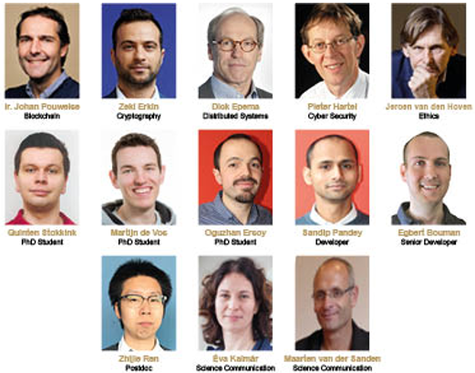
The Blockchain Lab

Slide 3

Tribler

Slide 4
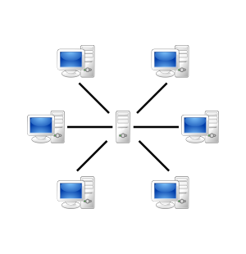
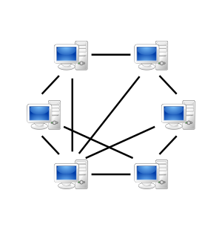
P2P Networks

Slide 5
P2P Networks
Pros
No single point of failure (More robust, no DDoS)
No congestion
No expensive server architecture needed
More efficient
Cons
No Accountability
Spyware (source is often not trustworthy)
No backup of data and no proper management
Updates are more difficult to do

Slide 6

P2P File-sharing
Agents up- and download files amongst one another
Each file is split into smaller pieces
Nodes that require a particular file join a swarm of other nodes with the same needed file organised as random mesh
Nodes know about pieces obtained by their neighbours
Nodes request desired pieces from their neighbours
Pieces aren‘t downloaded in sequential order

Slide 7
Tribler
P2P File-sharing network based on BitTorrent client
Blockchain based (Trustchain)
Open source
Anonymous (Based on Onion Routing)
Overlay Network for Content Searching (Independent of external websites for content discovery)
No central tracker necessary
Decentralised
„The only way to take Tribler down is to take down the internet“ – Johan Pouwelse (2009)

Slide 8
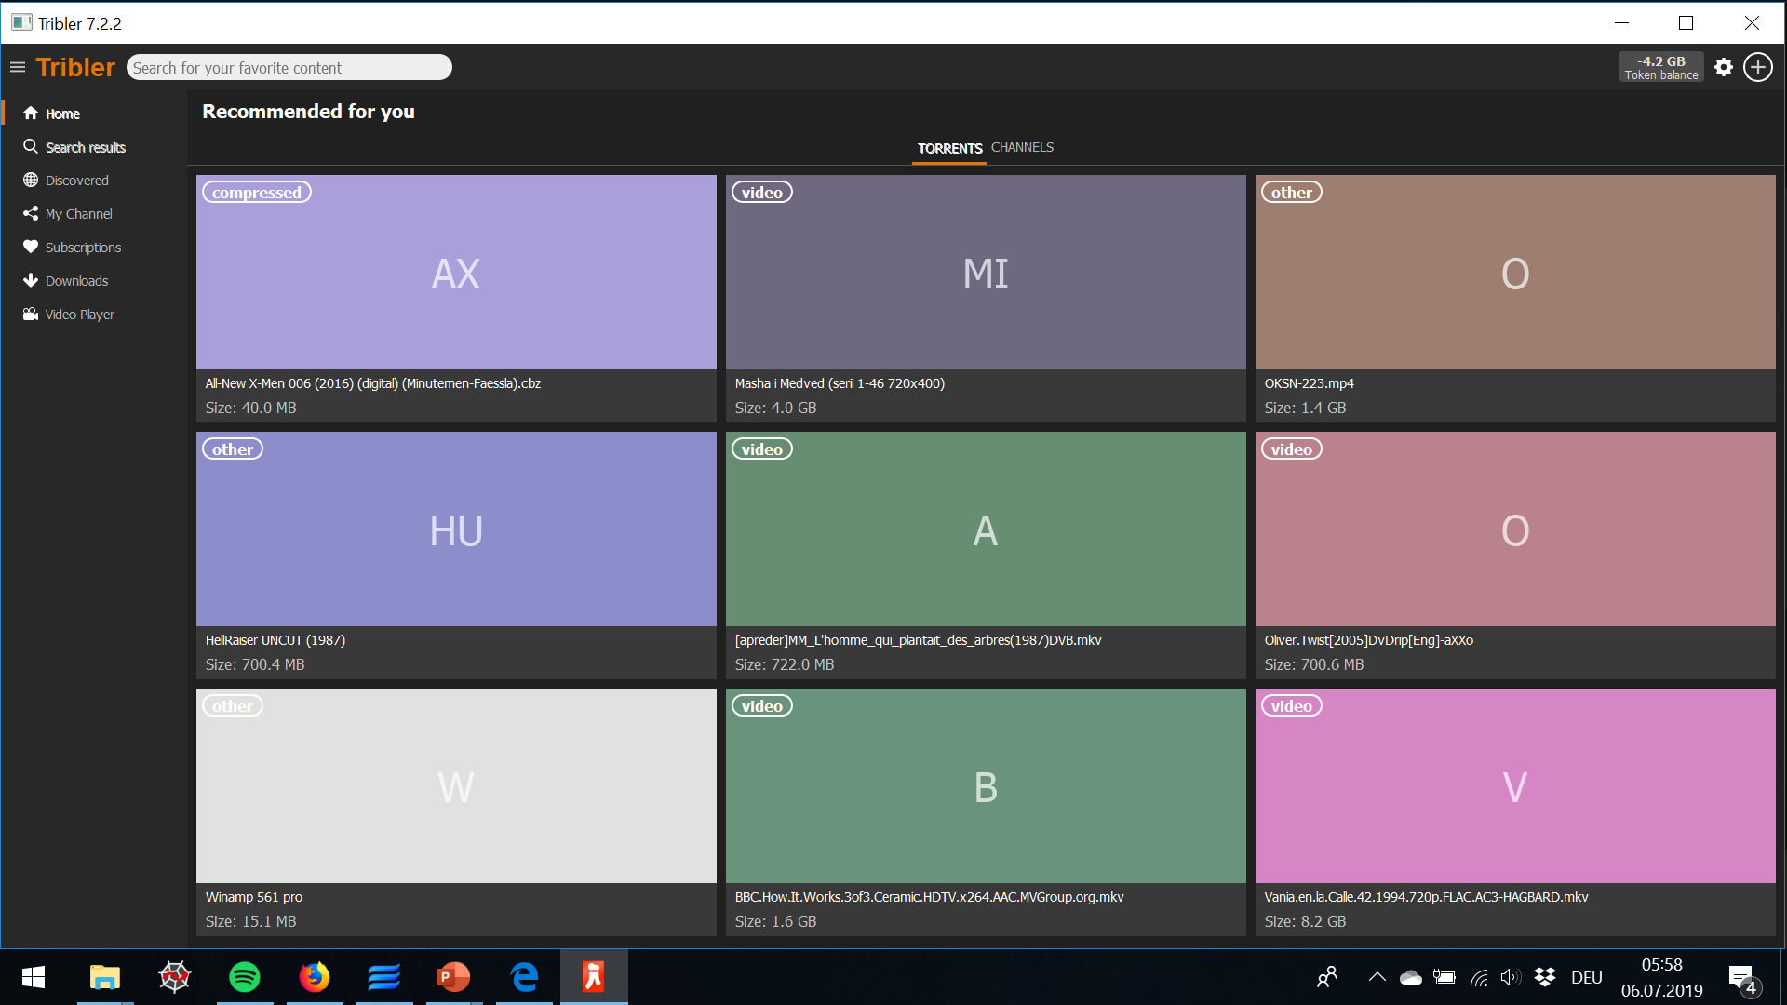
Tribler

Slide 9
Problem
It is beneficial to consume data, but not to contribute to others
Some agents may decide to only consume data (lazy freeriding)
How can we incentivise cooperation?
Reciprocity! Collaborators need to be rewarded

Slide 10
Current solution
BitTorrent uses a mechanism of direct reciprocity: Tit-for-Tat
A seeding peer (A) chooses 5 downloaders
4 with the highest upload rates to A
1 randomly chosen (optimistic unchoking)
If node B doesn‘t contribute to A, A „chokes“ out B
Node B can then only hope to be optimistically unchoked again (low probability, download much slower)

Slide 11
Problem with Direct Reciprocity
In Tribler interactions are often asymmetric and fleeting
Direct Reciprocity: Tit-for-tat
Relies on repeated encounters between the same people
Prisoner’s Dilemma
Defecting more beneficial than cooperation when swarms become too big
We look into Evolutionary Biology for mechanisms of cooperation in large populations

Slide 12
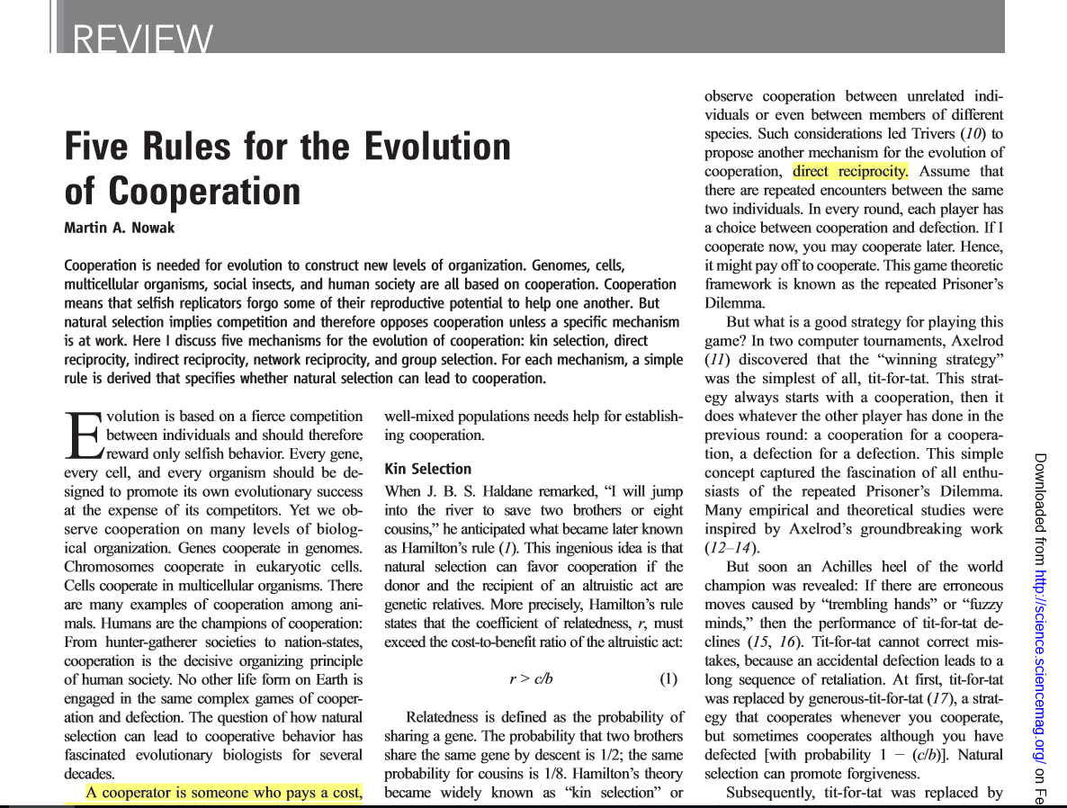

Slide 13
5 Rules of Cooperation
Kin Selection: Genetic relatives cooperate more reliably than strangers
Direct Reciprocity: A node cooperates so long as its partner node cooperates, else it defects
Indirect Reciprocity: Reputation fuels cooperation
Network Reciprocity: Cooperators form clusters in which nodes contribute to all of their neighbours
Group Selection: The network is partitioned into groups. Groups of cooperators grow and split while groups of defectors go extinct

Slide 14
5 Rules of Cooperation
Kin Selection: Genetic relatives cooperate more reliably than strangers
Direct Reciprocity: A node cooperates so long as its partner node cooperates, else it defects
Indirect Reciprocity: Reputation fuels cooperation
Network Reciprocity: Cooperators form clusters in which nodes contribute to all of their neighbours
Group Selection: The network is partitioned into groups. Groups of cooperators grow and split while groups of defectors go extinct

Slide 15
Implementing a Reputation Mechanism in a Distributed System
Design Goal: An algorithm, ranking agents based on their history of cooperation in the network (honour score)
Problem: This requires agents to know about each other‘s entire transaction history
How? BitTorrent does not keep track of every single data transfer

Slide 16
Transaction History
We need a database logging all transactions of agents in the network
Problem: Tribler is a distributed system, so no central authority to manage database
Solution: Distributed Storage Structure
Blockchain!

Slide 17
Blockchain 101
Public
Stored by every node
Tamper-proof
Append-only
Digital Signatures ensure transaction validity
Global consensus is achieved through PoW
Authority to append is randomised

Slide 18
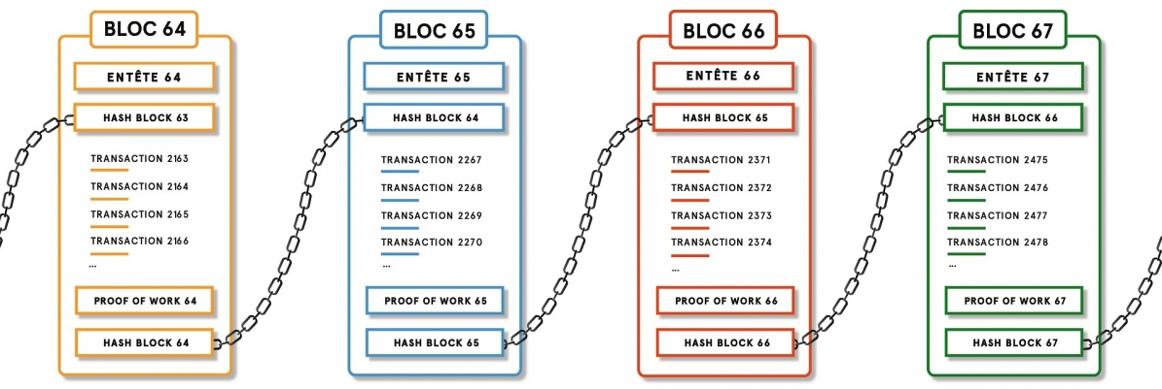
Blockchain 101
Problem: Global Consensus is prohibitively expensive
Slow transaction throughput

Slide 19
TrustChain 101
No global consensus (No PoW)
Not one chain, but a chain for every node
1 transaction per block
Social information available through gossip protocol (indirect observation model)
Much faster, but still secure

Slide 20
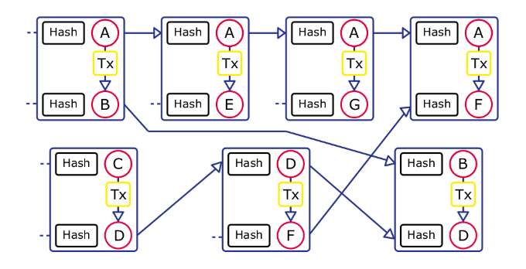
TrustChain 101

Slide 21
Back to Reputation
Design Goal: An algorithm, ranking agents based on their history of cooperation in the network (honour score)
What requirements does such a mechanisms need to satisfy to foster cooperation?

Slide 22
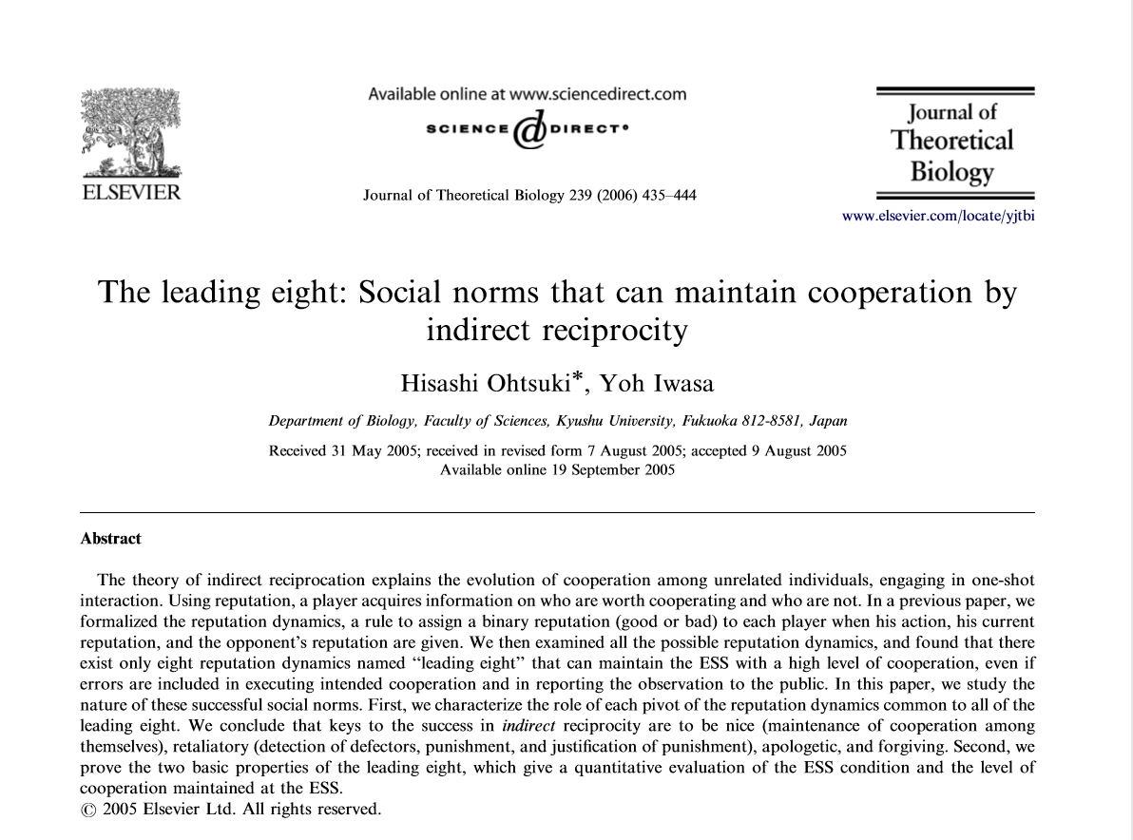

Slide 23
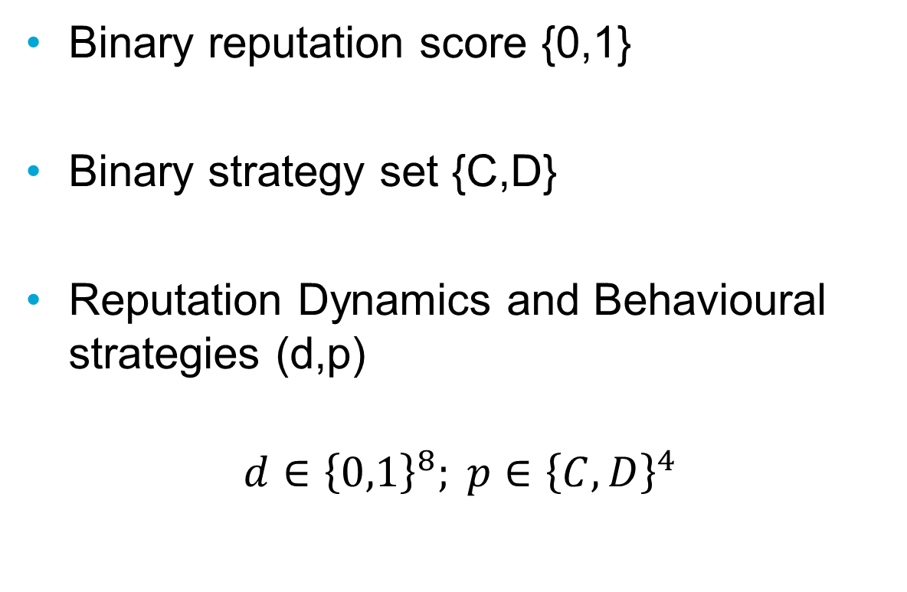
Social Norms
Binary reputation score {0,1}
Binary strategy set {C,D}
Reputation Dynamics and Behavioural strategies (d,p)
$$d∈{\left\{0,1\right\}}^{8}; p∈{\left\{C,D\right\}}^{4}$$

Slide 24
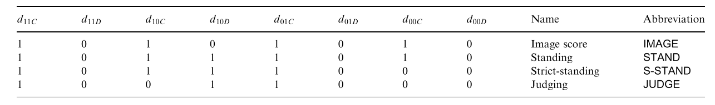
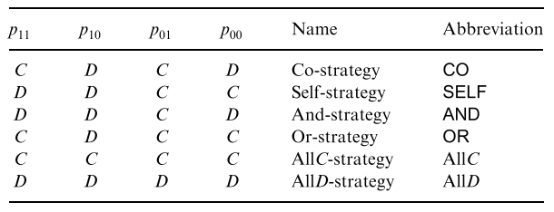
Social Norms
Reputation Dynamics
Behavioural Strategies

Slide 25
The Leading Eight
There are 161 ESS pairs
Among these we choose the 8 with the highest relative payoff
Leading Eight
We want an ESS pair that is part of the leading 8

Slide 26
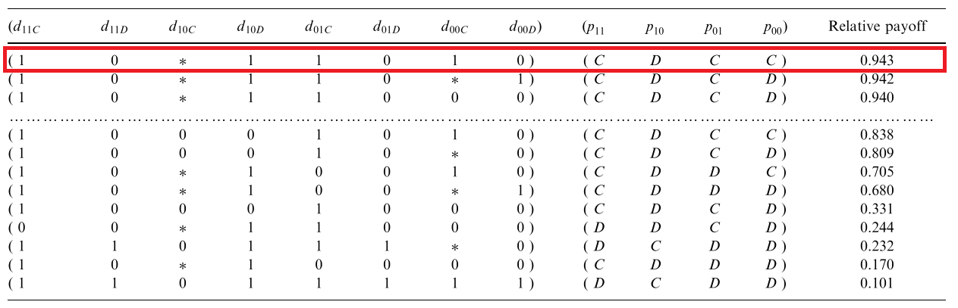
Social Norms
Evolutionary Stable Strategies (ESS)

Slide 27
ESS
Cooperate, punish, apologise, forgive
Cooperation with reputable people yields increase in reputation
Defection from low reputation people leads to higher reputation or at least does not decrease one‘s own reputation
Defectors can become cooperators again and will be rewarded

Slide 28
Differences between models
Reputation score is not discrete nor binary and should not be confined to {0,1}
Our algorithm should be based on an agent‘s entire history and not just the latest interaction
There are no rounds and no generations in Tribler; agents rarely disappear
We initially disregard execution and assignment errors
Defection is not immediately punished by reducing reputation.

Slide 29
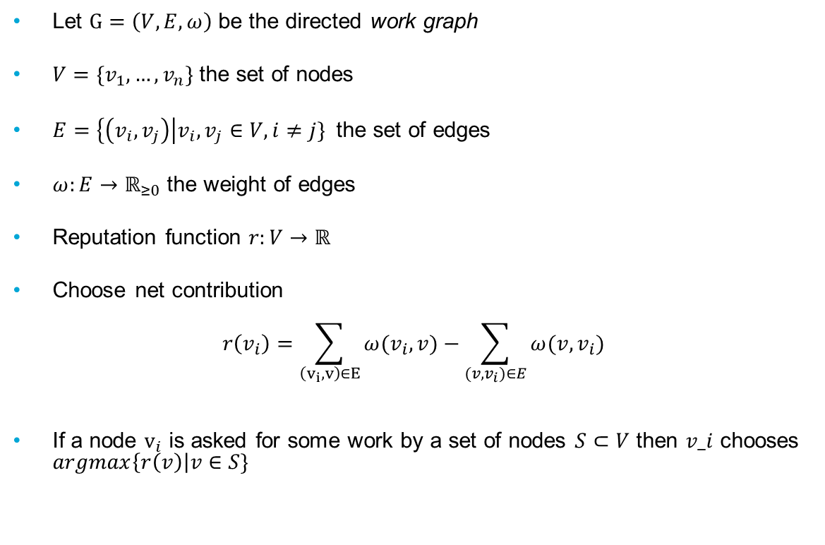
A trivial approach
Let $G=\left(V,E,ω\right)$ be the directed work graph
$V=\{v_{1},…,v_{n}\}$ the set of nodes
$E=\left\{\left(v_{i},v_{j}\right)\right|v_{i},v_{j}∈V, i≠j\}$ the set of edges
$ω:E→ℝ_{≥0}$ the weight of edges
Reputation function $r:V→ℝ$
Choose net contribution
$$r\left(v_{i}\right)=\sum_{\begin{aligned}\left(v_{i},v\right)∈E \\ \end{aligned}}{ω(v_{i},v)}−\sum_{(v,v_{i})∈E}{ω(v,v_{i})}$$
If a node $v_{i}$ is asked for some work by a set of nodes $S⊂V$ then $v_i$ chooses $argmax\left\{r\left(v\right)\right|v∈S\}$

Slide 30
The Problem with non-unique Identities
Identities are not unique. A user can create as many accounts as they like at a relatively small cost
This leads to:
Whitewashing Attacks
Sybil Attacks

Slide 31
Sybil Attacks
A user can create large numbers of fake accounts
Digital Signatures no longer prevent fake transactions
Reported edge weights can no longer be trusted, except for those connected to oneself
Global reputation is no longer a reliable metric
We look into trust instead of reputation

Slide 32
Existing Algorithms
BarterCast: Based on Maxflow algorithm
TrustRank: Based on PageRank algorithm
Netflow
DropEdge
Capflow

Slide 33
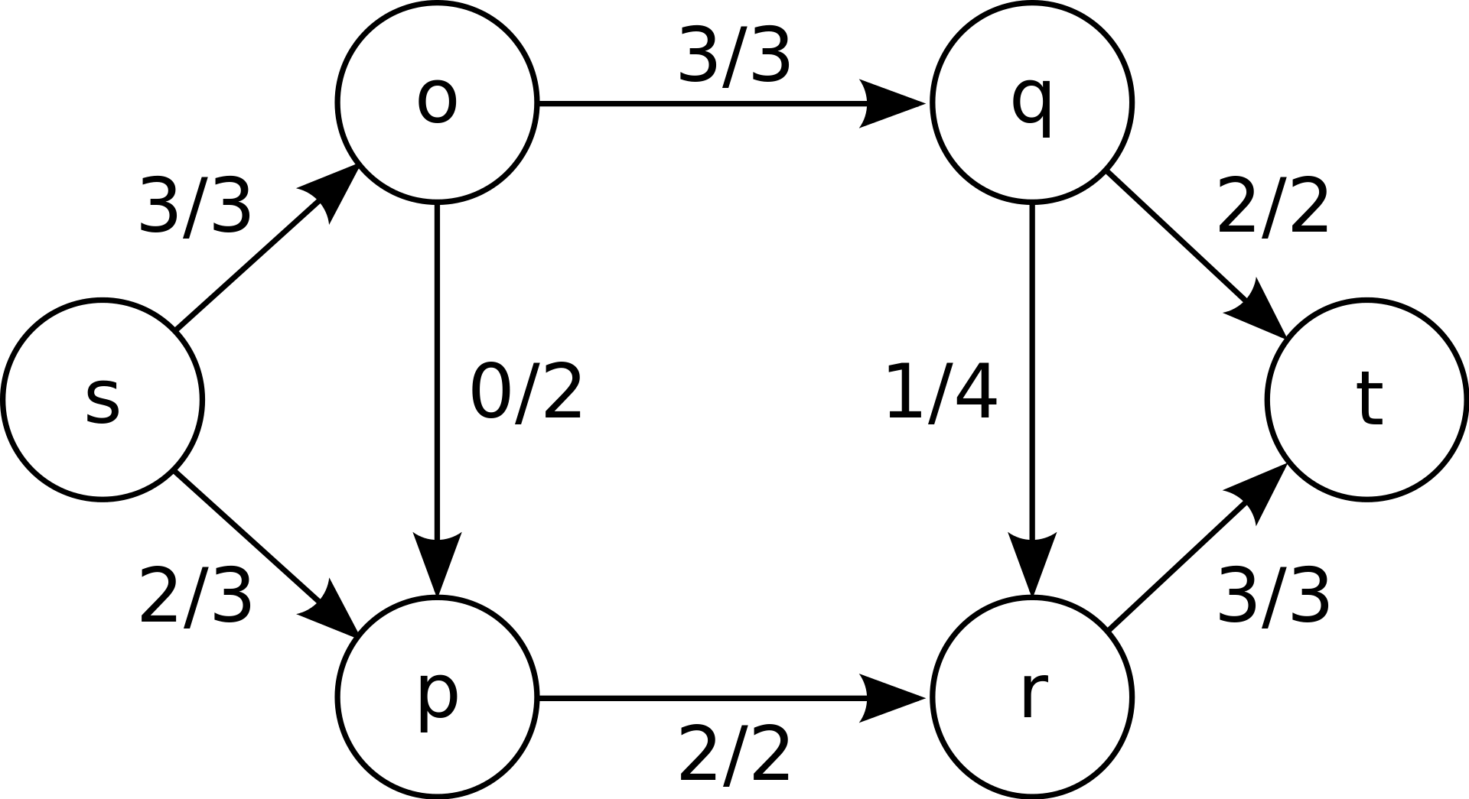
The Maxflow Algorithm
Measures the maximum amount of data flow between two nodes

Slide 34
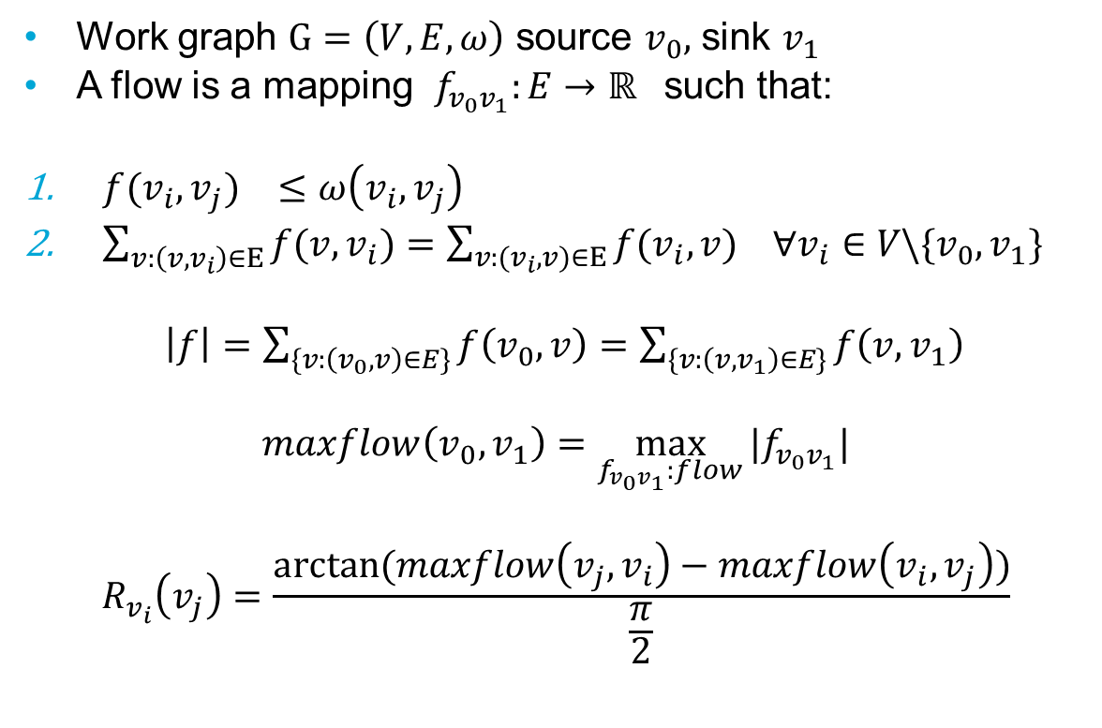
Maxflow
Work graph $G=\left(V,E,ω\right)$ source $v_{0},$ sink $v_{1}$
A flow is a mapping $f_{v_{0}v_{1}}:E→ℝ_{}$such that:
${f(v_{i},v_{j})}_{}≤{ω\left(v_{i},v_{j}\right)}_{}$
$\sum_{v:\left(v,v_{i}\right)∈E}{f(v,v_{i})}=\sum_{v:(v_{i},v)∈E}{f(v_{i},{v)}_{}}∀v_{i}∈V\backslash \{v_{0},v_{1}\}$
$\left|f\right|=\sum_{\{v:\left(v_{0},v\right)∈E\}}{f\left(v_{0},v\right)}=\sum_{\{v:\left(v,v_{1}\right)∈E\}}{f\left(v,v_{1}\right)}$
$$maxflow\left(v_{0},v_{1}\right)=\max_{f_{v_{0}v_{1}}:flow}{|f_{v_{0}v_{1}}|}$$
$$R_{v_{i}}\left(v_{j}\right)=\frac{arctan⁡(maxflow\left(v_{j},v_{i}\right)−maxflow\left(v_{i},v_{j}\right))}{\frac{π}{2}}$$

Slide 35
Sybil Resistance
BarterCast prevents lazy freeriding, and mitigates Sybil attacks to some extent
The amount of trust gained by sybil identities is limited by the size of the attack edges
However, large sybil regions can still gain massively through this attack

Slide 36
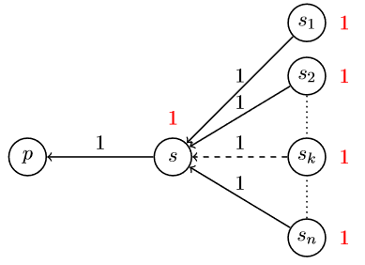
Example of Sybil attack
Bartercast does not prevent die-hard sybil attacks

Slide 37
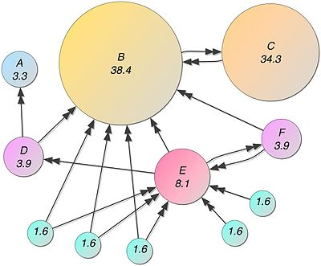
The PageRank Algorithm
Designed to rank webpages based on their importance
Importance Reputability

Slide 38

Mathematics of PageRank
PageRank is recursively determined by
with

Slide 39
Current Implementation
Approximate the PageRanks
Monte Carlo method
Simulate a large number of random walks
The PageRank of a node is determined by the times it is visited by the random walks

Slide 40
Our Requirements
Personalisation: Trust is personal
Locality: Trust is transitive*
Incrementality: Trust is dynamic
* but not too much

Slide 41
Sybil Attacks
What‘s preventing large scale Sybil attacks?
Answer: Locality & Personalisation!
Due to personalisation global attacks and large Sybil regions are not profitable
Trustrank does not capture enough nodes in the graph, so not very informative

Slide 42
Problems with PageRank and MaxFlow
Maxflow rewards Sybil attacks with large numbers of identities
PageRank random walks are too short to cover entire network (downside to locality)
The pagerank is a highly unstable measure, showing frequent rank reversals after small adjustments of the jump parameter. It‘s only useful for the most important nodes. Not all

Slide 43
Existing Algorithms
BarterCast: Based on Maxflow algorithm
TrustRank: Based on PageRank algorithm
Netflow: Maxflow, but capped by the net contribution
DropEdge: BarterCast made misreport proof
Capflow: Introduce a cap for nodes‘ willingness to make contributions

